Slide 1
IDE-IT FrontEnd
Puja Ramanathan, Alyssa Ricketts, Rachel Zigman
Notes:
Rachel - Think of fun creative question

Slide 2



Motivation
Importance
Problem
Powerful tools:
Code insight
Debugging
Resource Management
Unused functionality
Low discoverability
Accessibility
Awareness
Configuration
Notes:
Rachel

Slide 3




Current Approaches & Limitations
 | Requires prior knowledge | Irrelevant | Interrupts Flow
- MouseFeed - Key Promoter X
Features Trainer
Tips of the Day
Web Searches

Slide 4

Current Approaches & Limitations
 | Requires prior knowledge | Irrelevant | Interrupts Flow
- MouseFeed - Key Promoter X
Features Trainer
Tips of the Day
Web Searches

Slide 5
Current Approaches & Limitations
 | Requires prior knowledge | Irrelevant | Interrupts Flow
- MouseFeed - Key Promoter X
Features Trainer
Tips of the Day
Web Searches

Slide 6
Current Approaches & Limitations
 | Requires prior knowledge | Irrelevant | Interrupts Flow
- MouseFeed - Key Promoter X
Features Trainer
Tips of the Day
Web Searches

Slide 7
Current Approaches & Limitations
 | Requires prior knowledge | Irrelevant | Interrupts Flow
- MouseFeed - Key Promoter X
Features Trainer
Tips of the Day
Web Searches

Slide 8
Implementation
Notes:
Alyssa - Make annotated and update

Slide 9
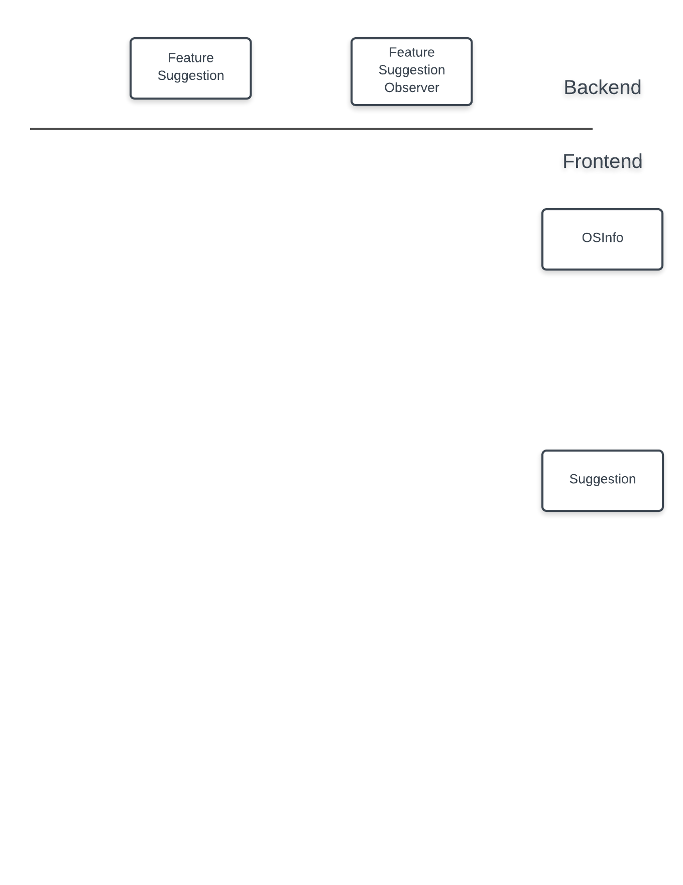
Implementation
Notes:
Alyssa - Make annotated and update

Slide 10
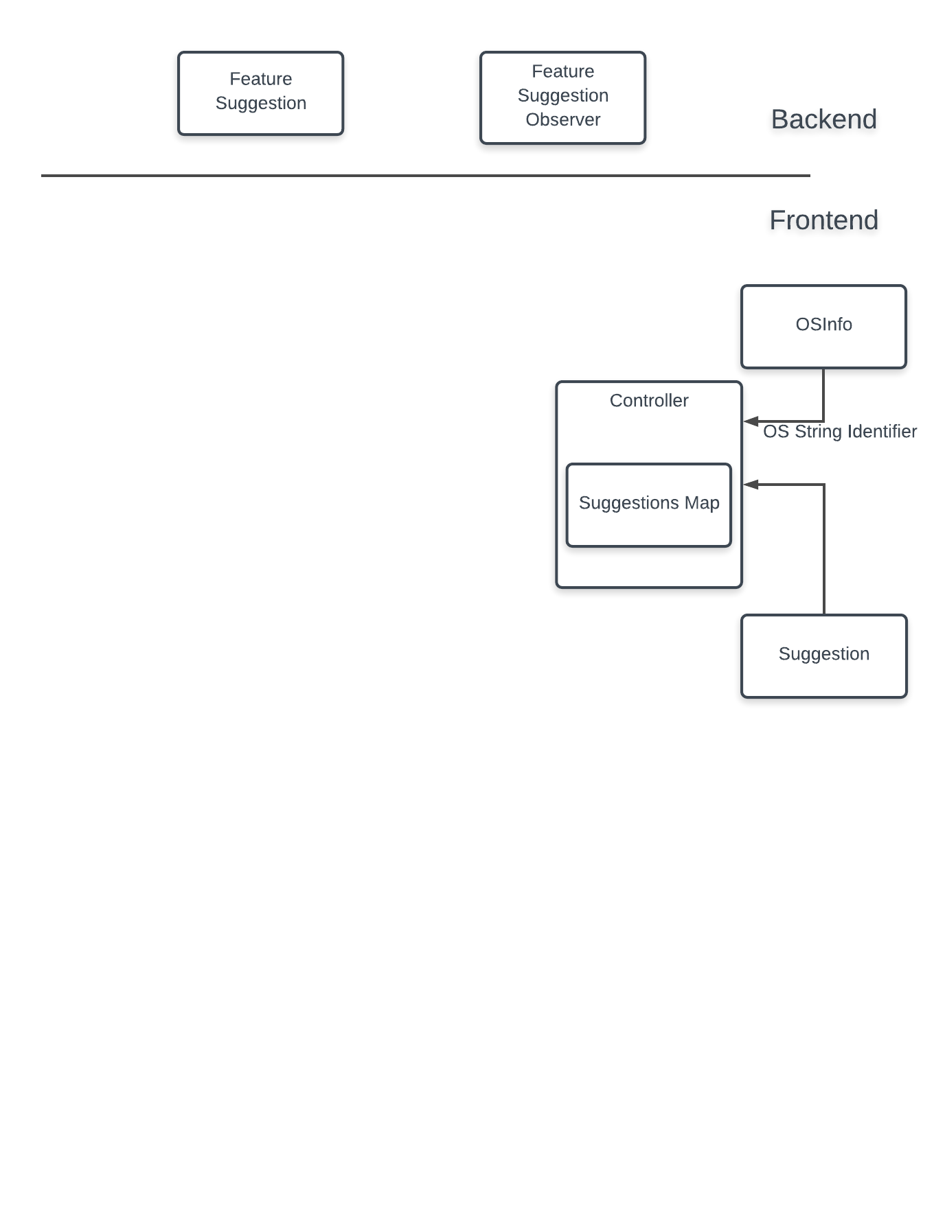
Implementation
Notes:
Alyssa - Make annotated and update

Slide 11
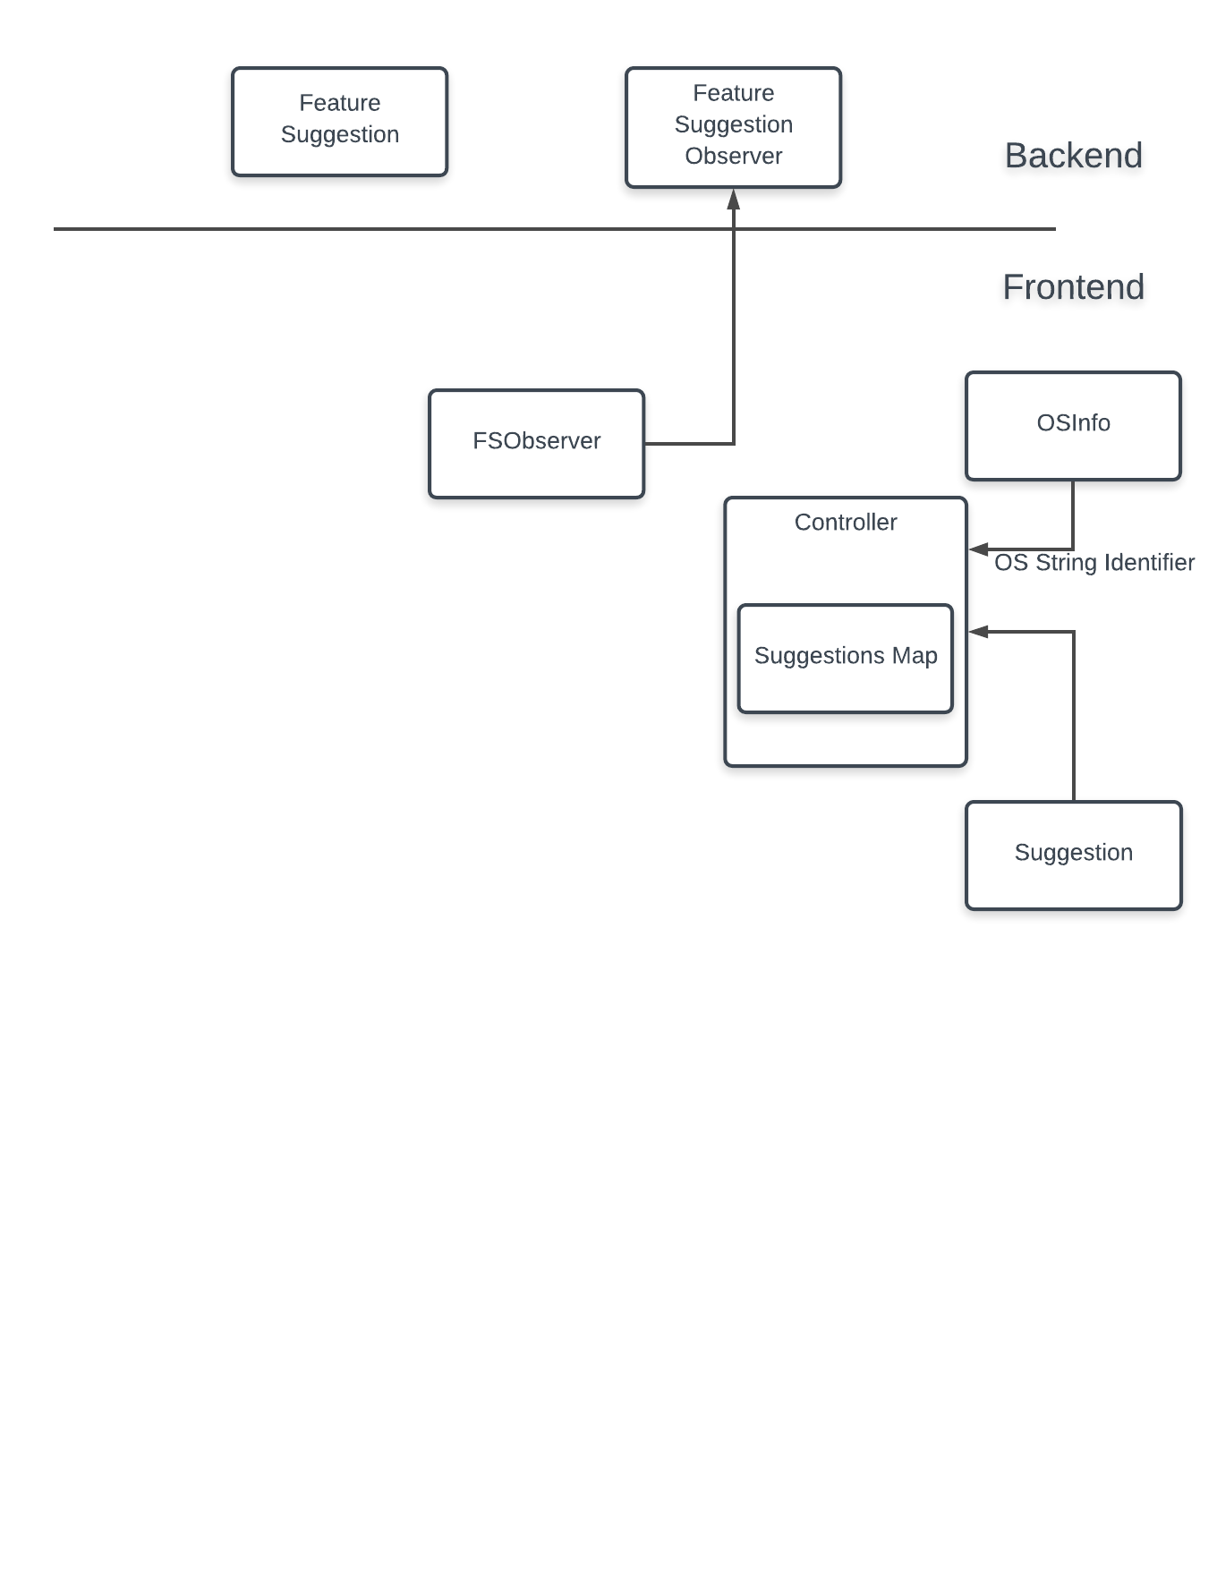
Implementation
Notes:
Alyssa - Make annotated and update

Slide 12

Implementation
Notes:
Alyssa - Make annotated and update

Slide 13
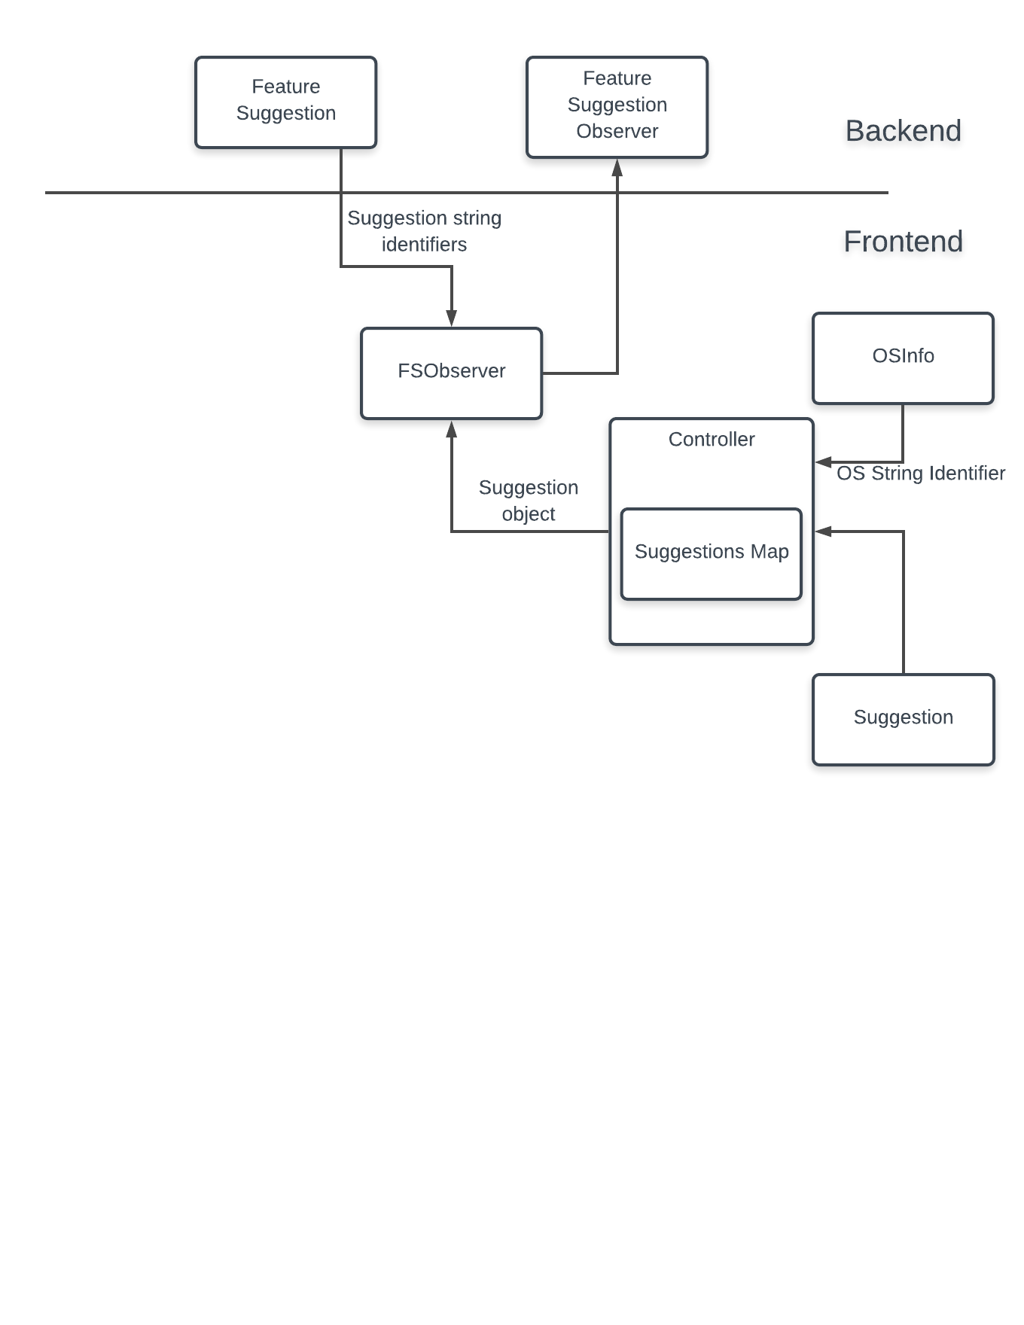
Implementation
Notes:
Alyssa - Make annotated and update

Slide 14
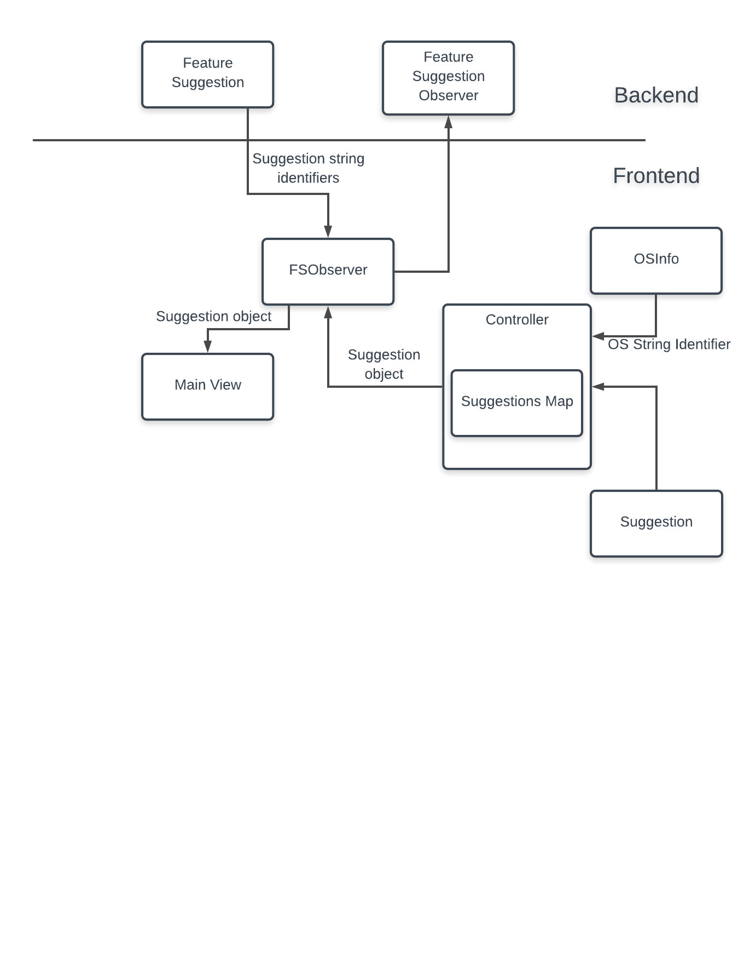
Implementation
Notes:
Alyssa - Make annotated and update

Slide 15
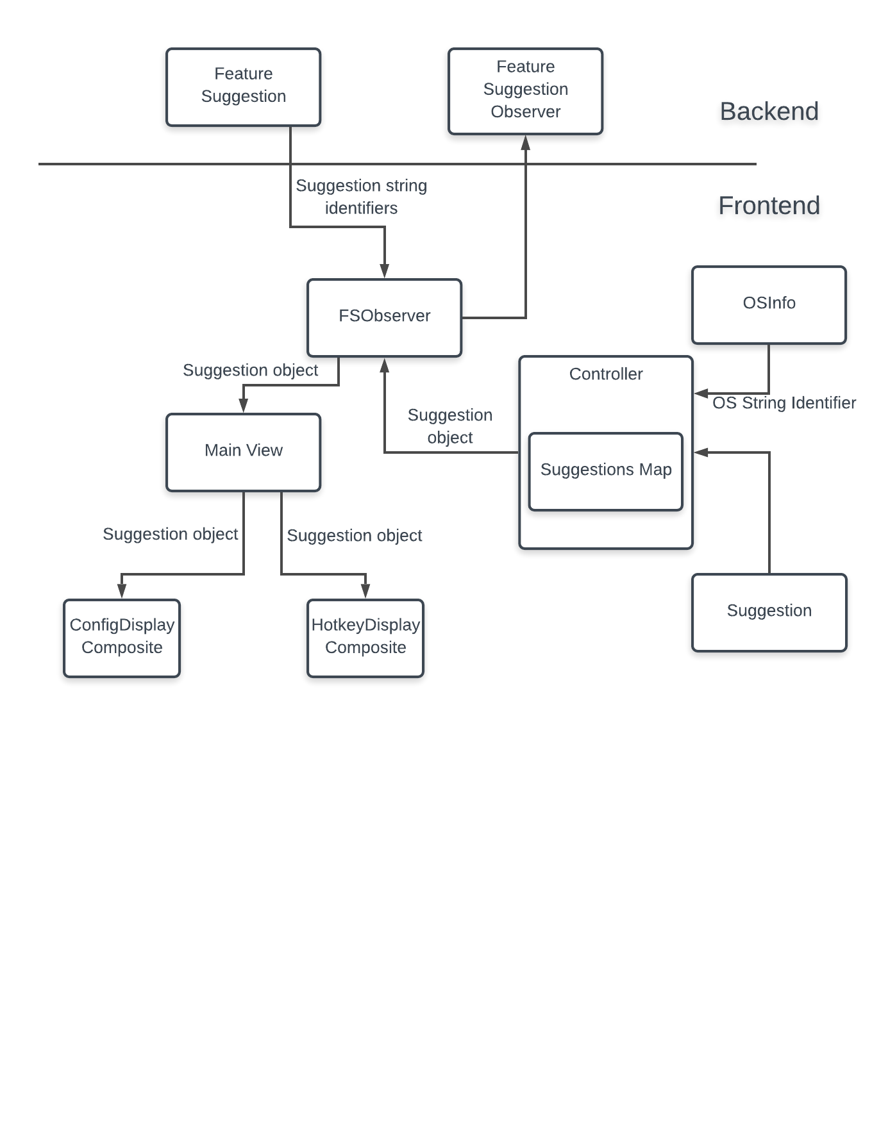
Implementation
Notes:
Alyssa - Make annotated and update

Slide 16

Notes:
Alyssa

Slide 17

Design Decisions
Hotkey tips appear 3 times
Preference suggestions appear once
Certain preferences appear on launch
No backend support
Notes:
Rachel - hotkey tips
Alyssa - preferences

Slide 18

Evaluation
Measuring success:
Correct functionality
Users response to interface
User testing with script
Follow-up survey
Target group: new developers
Notes:
rachel

Slide 19
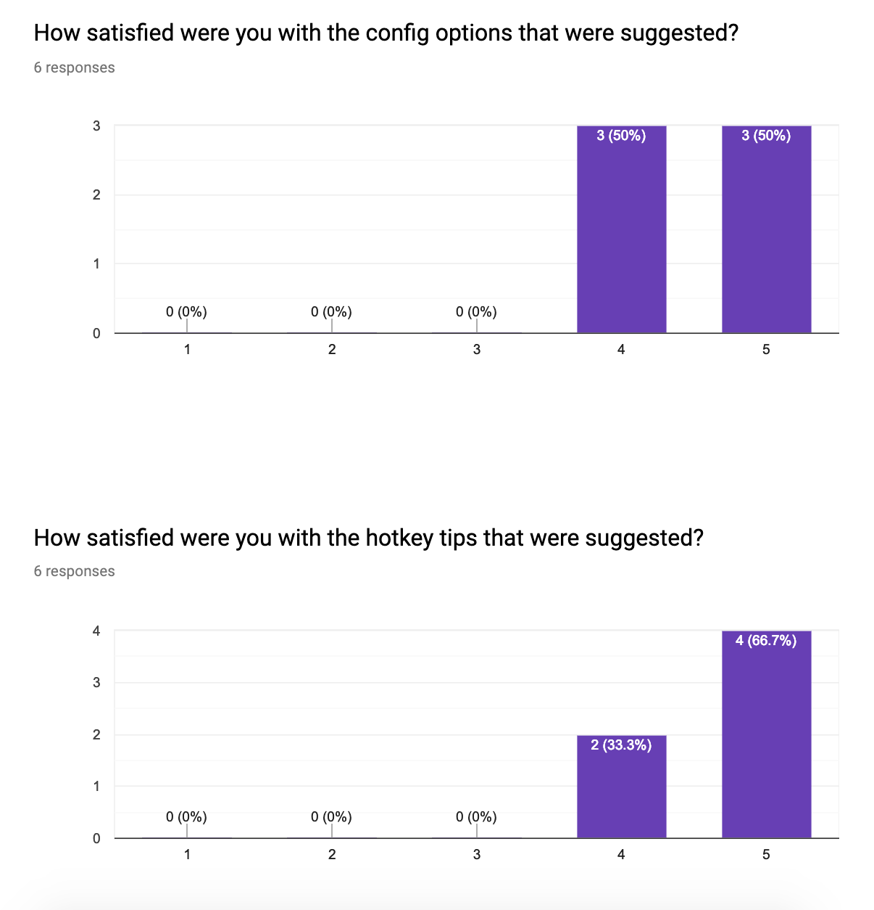
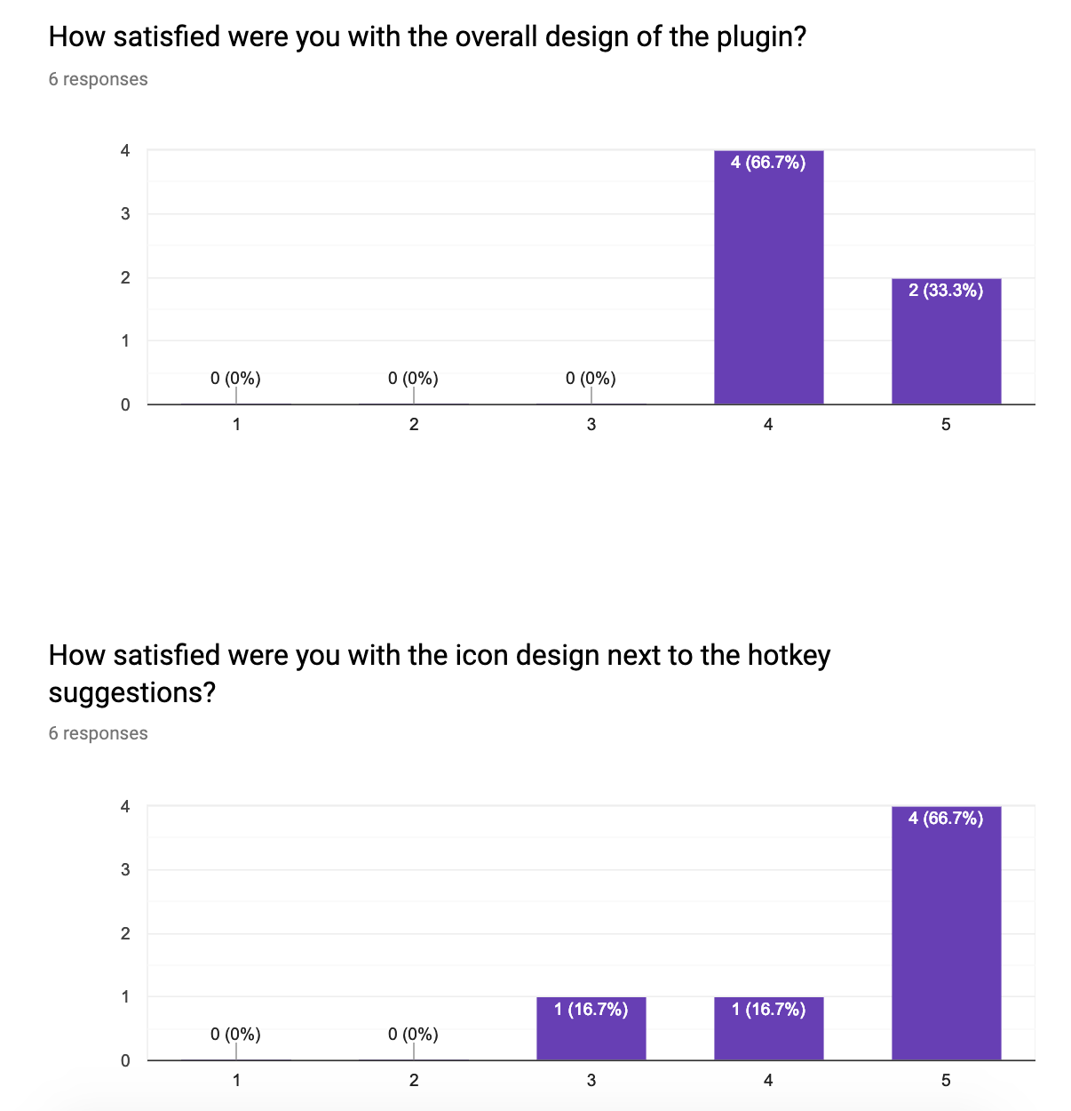
User Studies
Scale 1-5 (Very unsatisfied to very satisfied)
Notes:
rachel

Slide 20
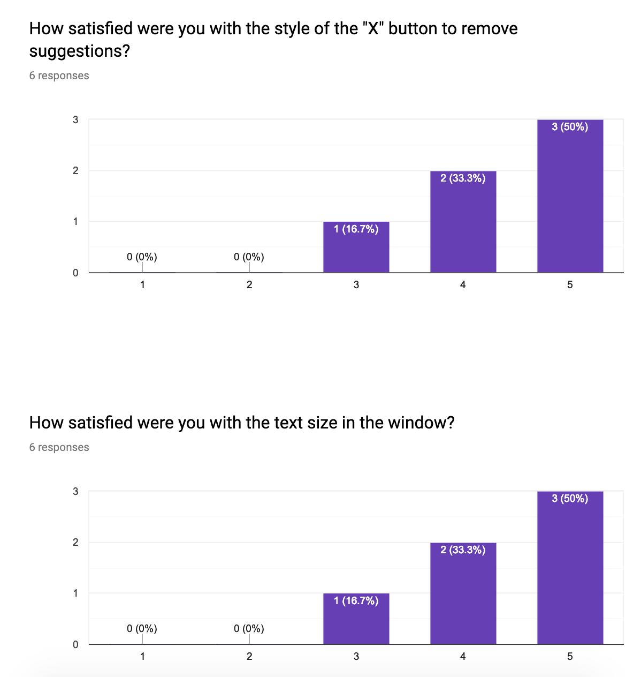
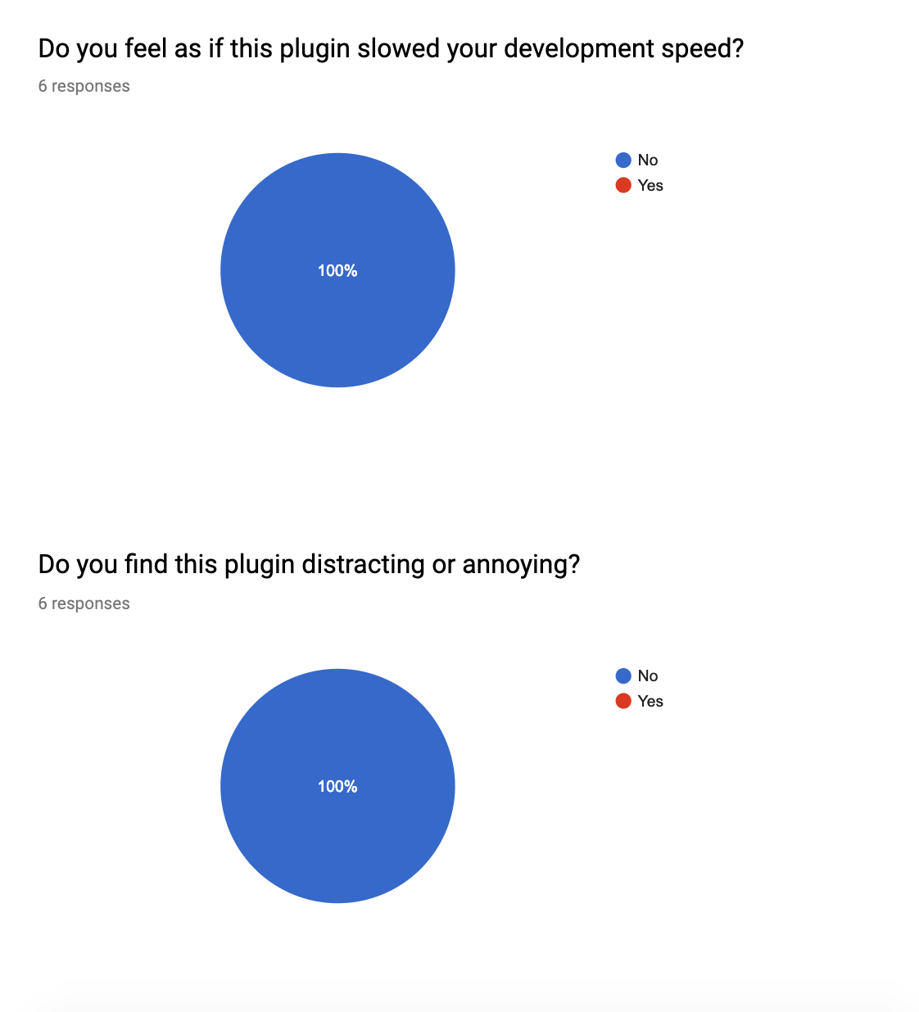
User Studies
Scale 1-5 (Very unsatisfied to very satisfied)

Slide 21
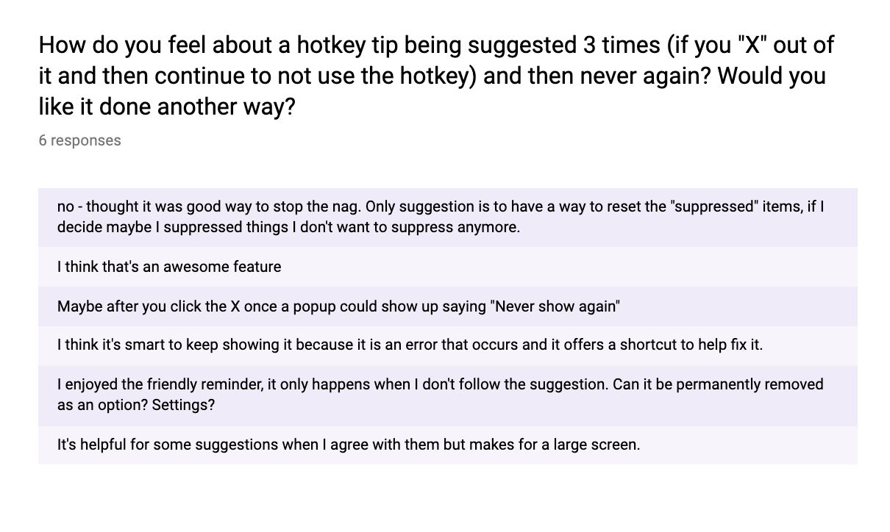
User Studies

Slide 22

Improvements
Formatting
More configs/hotkey tips
Combined repo - one plugin
Operating system addition
Notes:
Rachel

Slide 23

Future Work
New suggestions appear at top
Add to Eclipse marketplace
Store users default preferences
Notes:
Alyssa

Slide 24
Takeaways
Use of IDEs for code insight and resource management
Introduction of discoverability with an easy-to-use plugin window
Low distractibility and workflow interruption
Notes:
Rachel

